Slide 1
State Panel: Expanding Your Reach May 7, 2020
Troy Grant, Tennessee
Lais Martinez, Utah
Heather McChesney, West Virginia

Slide 2
Tennessee Higher Education Commission
Troy Grant
Senior Director of College Access

Slide 3
What are Path to College Events?
Events include:
College Application Week (fall of senior year)
College Planning Nights (junior year)
TN FAFSA Frenzy (fall of senior year)
College Signing Day (May of senior year)
Expansion to include elementary and middle schools occurred during the 2017-18 school year
Notes:
Path to College events increase the college-going culture in schools and provides increased insight to the college-going process as students approach high school graduation.
Each school is different and we want to encourage them to plan events that work for their school contexts

Slide 4
Why expand?

Slide 5
Growing School Participation
In our first year of expansion, school participation in Path to College Events grew by over 100%!
For 2017–2018, 703 schools and 13 community organizations registered
314 High Schools
333 Elementary and Middle Schools
38 K12 schools
18 Middle/High Schools
For 2019–2020, 947 schools and 5 community organizations registered

Slide 6
Tips for Increasing Participation
1) Path to College School Designation
Register for Path to College events by Sept. deadline
Host all 4 Path to College events
Complete post-event survey for each event
Notes:
Schools were picking and choosing which events to host.
Seen an increase in survey response rate
Surveys ask about participation and best practices

Slide 7
Tips for Increasing Participation
2) Host regional meetings/trainings and maximize partnerships
Partnered with DOE to host regional counselor “collaborative” trainings
Covered new TN Counseling Standards and PTC events as resource for implementing standards
Structured and regular communication during the registration period.
Notes:
Allowed counselors time to plan in the trainings and collected the plans which resulted in the collection of many new best practices and creative ideas

Slide 8
Notes:
On the fence about whether or not to include this slide since its not that applicable to others outside the state.

Slide 9
Tips for Increasing Participation
3) Use Data
Surveys emphasize data as a part of Path to College events (number of students served, event attendance)
Having that data allows us to strengthen recruitment of new schools

Slide 10
Tips for Increasing Participation
3) Resource Development
Create specific resources for various student age groups.
Activities
Worksheets
Reading Lists
Resource mailing has been a good incentive to drive participation in Tennessee
Stickers
Posters

Slide 11
Path to College Resources
Resource Guides + Customizable Templates
Implementation Ideas and Resources
Volunteer Recruitment Tips
Event Promotion Resources
https://www.collegefortn.org
Notes:
Mention that College Planning Night has a ppt… not a resource guide
Show examples on next slide

Slide 12
Path to College Resources

Slide 13
Path to College Resources
2) Annual Resource Mailings
Stickers, Posters, & Wall Clings
Registration managed through Formstack
Schools registered for ALL 4 Events
Funded by GEAR UP

Slide 14
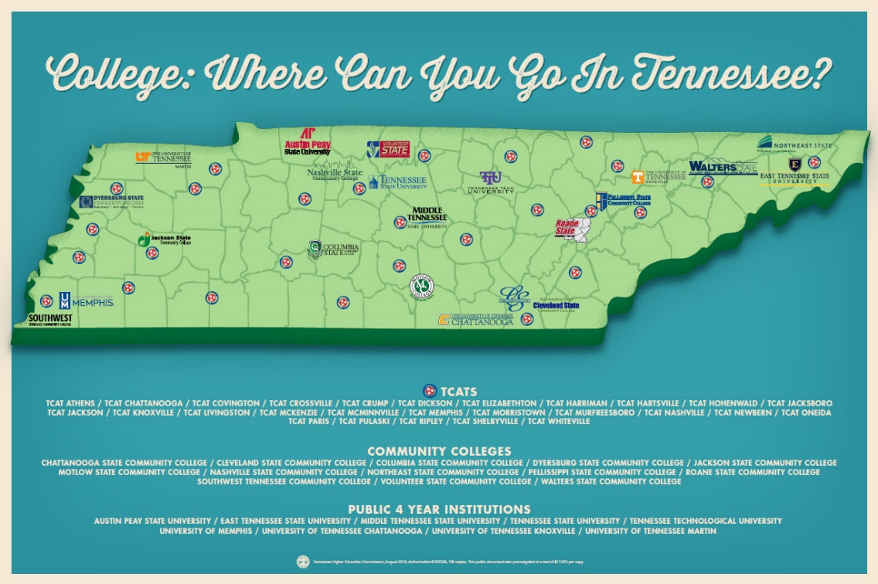

Slide 16
Path to College Resources
3) Creating Buzz in the Media
#TNCollegeAppWeek
Notes:
Courtney, I envision you taking this slide since its your world ☺

Slide 17
What Did We Learn?
There are varying levels of “buy in”
Counselors are hungry for implementation ideas and resources-- especially resources for elementary and middle school. Go beyond the idea and provide tools for implementation.
Providing a carrot was important to our expansion
Utilizing Tennessee’s Counselor Collaborative structure was effective
Train – Implement – Celebrate - Repeat
Notes:
Varying levels of buy in- counselors use the resources very differently across the state. While we want to encourage schools to use the resources and adapt the events for what works best in their context, we want them to use them to their full potential. From reading the surveys, some of the events are driven solely by the work of the counselor and in an ideal world, the entire school community would be involved and “bought in”. So in our next iteration of the PTC resources, we created a college going culture assessment and powerpoint that can be used to both educate the school about the importance of creating a college going culture and as a tool for self reflection.

Slide 18
Tennessee Higher Education Commission
Troy Grant
troy.grant@tn.gov
Senior Director of College Access

Slide 19
UTAH COLLEGE APPLICATION WEEK (UCAW) EXPANDS REACH TO NEW AUDIENCES
Laís K. Martinez
College Access Coordinator, USHE
May 7, 2020

Slide 20
UTAH OVERVIEW & IMPACTS
2019 USHE Student Survey, 60% response rate with UCAW participants

Slide 21
43%
of UCAW high school seniors identify as first-generation students.
2019 USHE Student Survey, 60% response rate with UCAW participants

Slide 22
BREAKDOWN: WHERE DID UCAW STUDENTS APPLY?
Utah students stay in Utah!
2019 USHE Student Survey, 60% response rate with UCAW participants
Notes:
What we know about Utah students applying for college:
Obtaining a 4-year college degree is very much the norm in Utah. It is part of the culture and value placed in education
UTECH is merging with USHE and there are a lot of opportunities to collaborate and work together, however, through an equity lens there will be a lot of work needed to ensure that students are not tracked into one or the other.

Slide 23
EXPANDING THE UCAW REACH TO YOUNGER GRADES
Elementary Schools
Middle/Jr High Schools
16 schools officially registered to participate
150 schools were sent Monte Books college awareness materials
Door decorating contest
Age appropriate activities (ie. my529 crossword puzzle, etc.)
20 schools registered to participate
Writing hip hop pedagogy personal statement workshops with GoGirlz, Latinos in Action (LIA), People of the Pacific (POP),TRIO, GEAR UP and AVID
Researching colleges activity

Slide 24
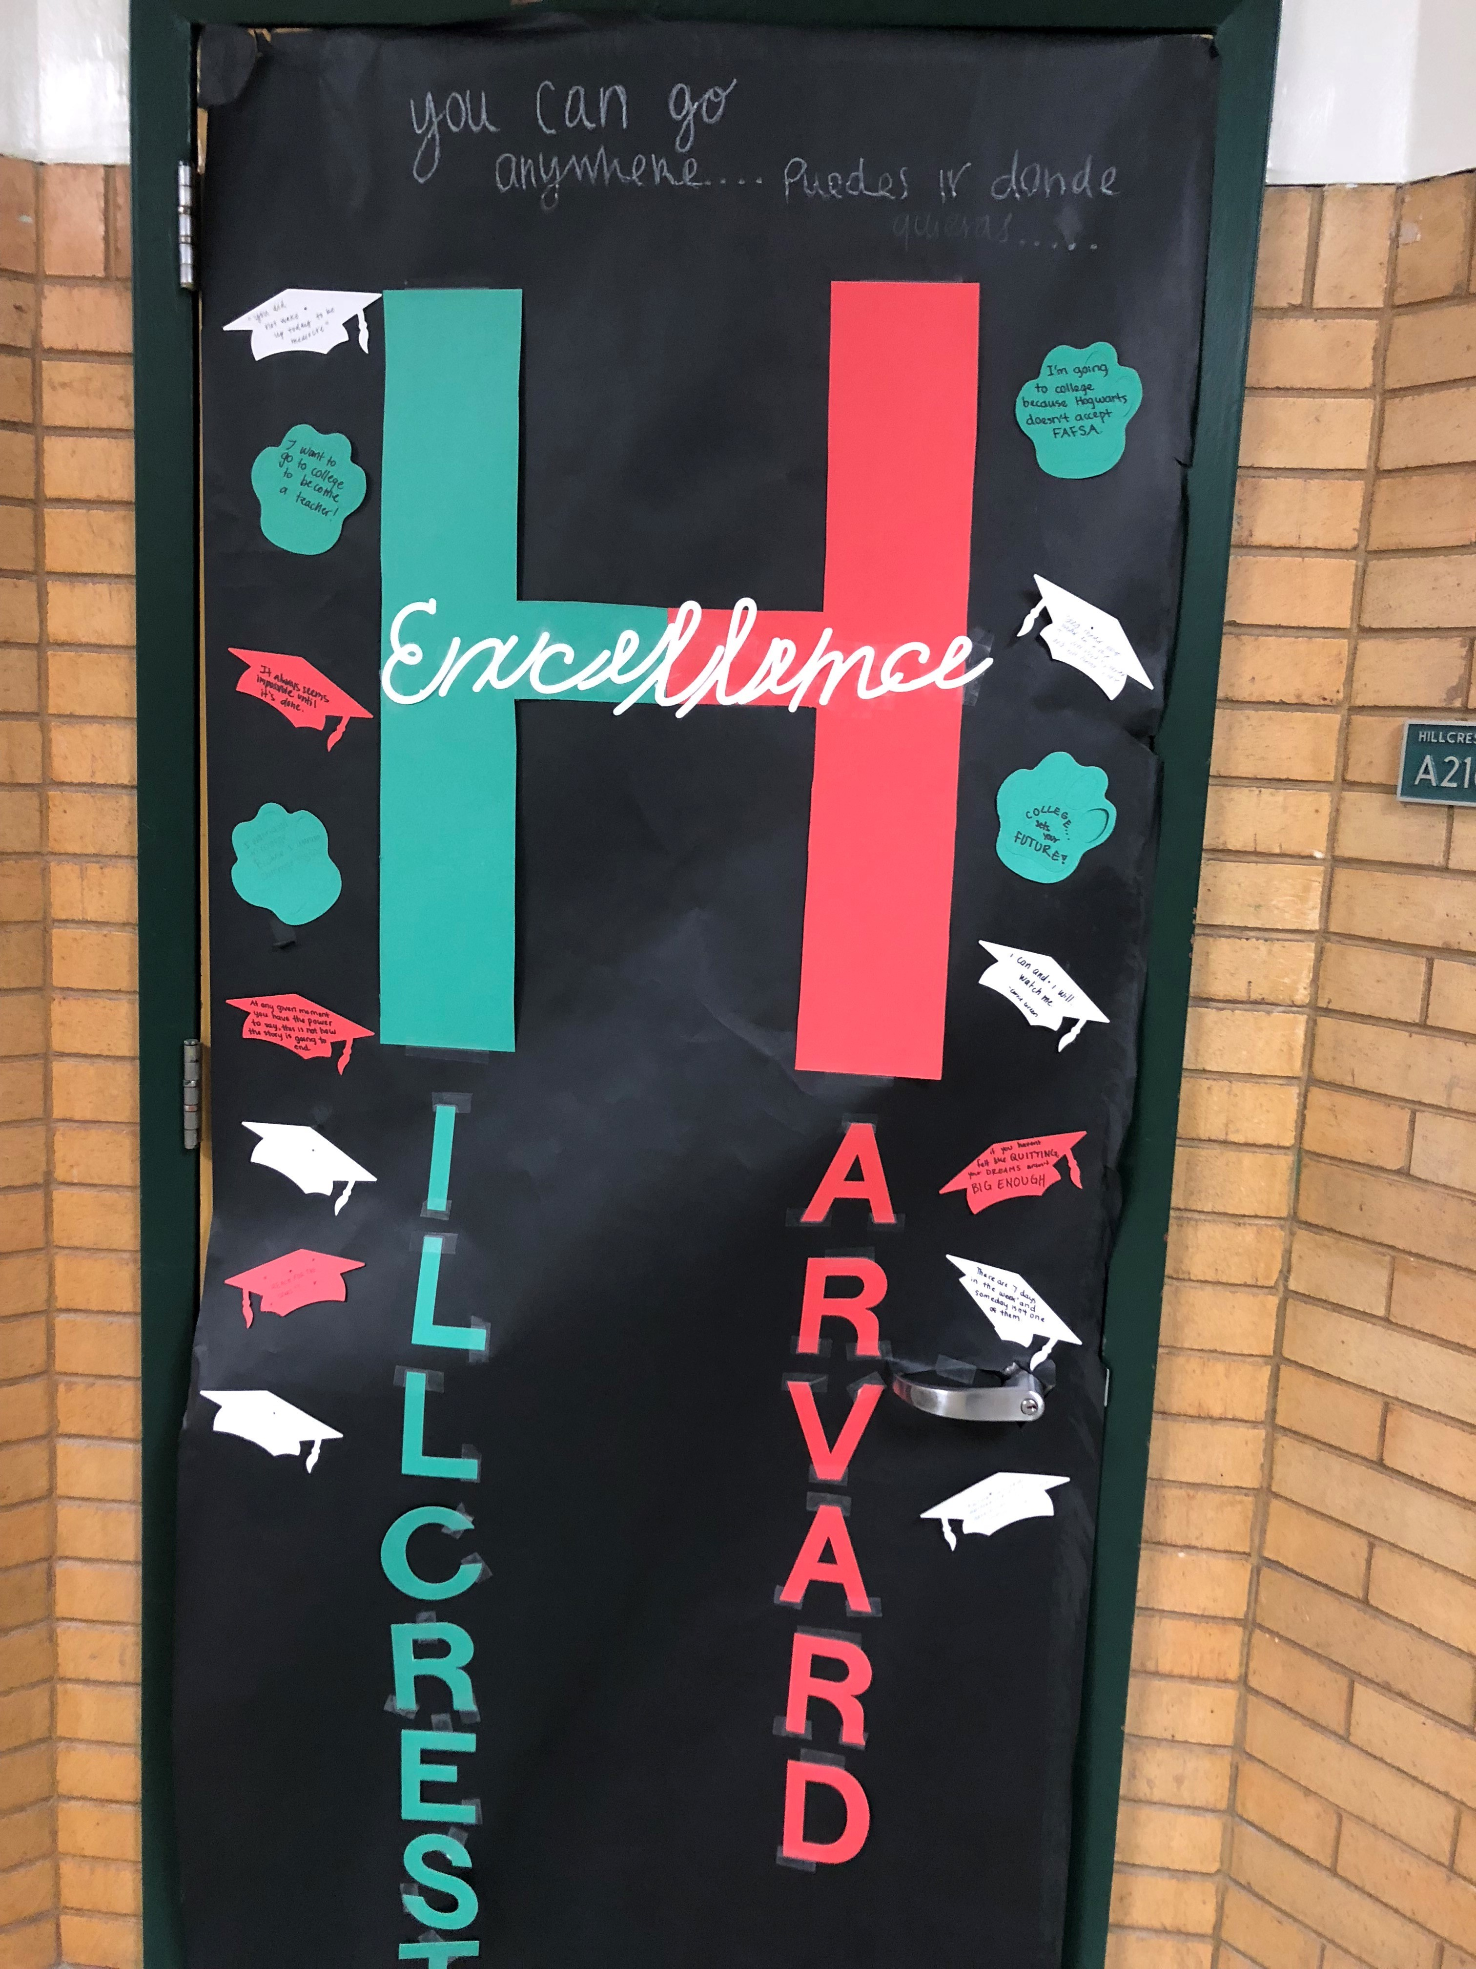
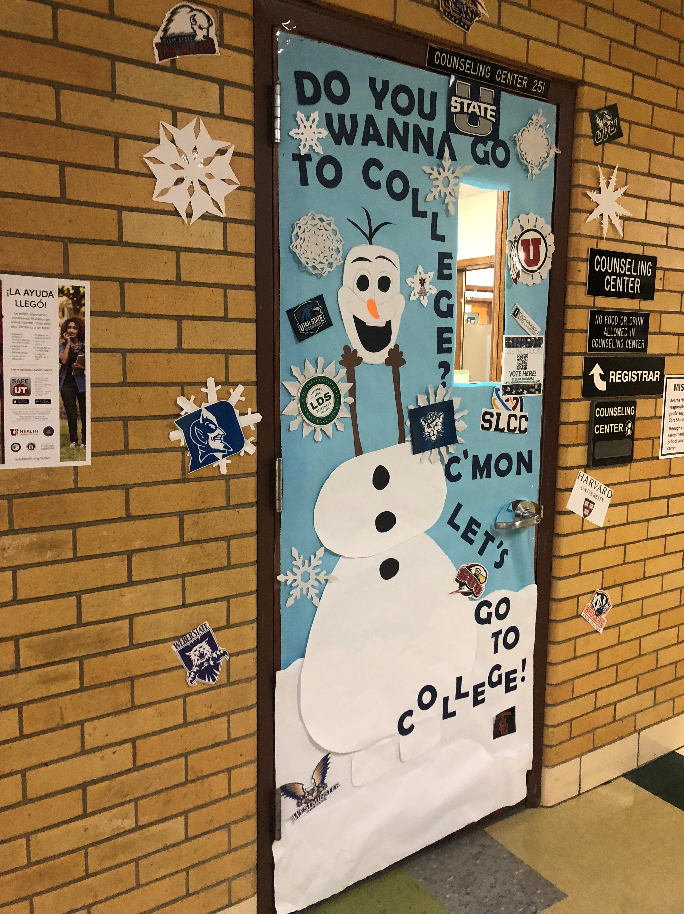

Slide 25
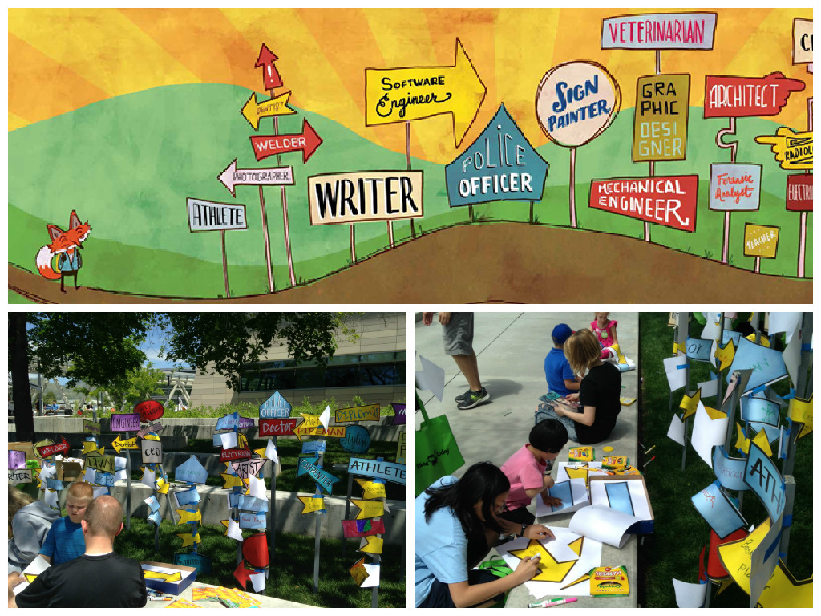
MONTE BOOKS
USHE published Monte and the World of Possibilities in October 2014. In the children’s book, the main character, Monte, has a lot of questions about the world around him, with one of them being, “Can I go to college?” In the end, he realizes that school, and college in particular, can help him follow his dreams. The book was developed for second and third graders, and is available at no charge for teachers and parents to incorporate into their college discussions with students.

Slide 26
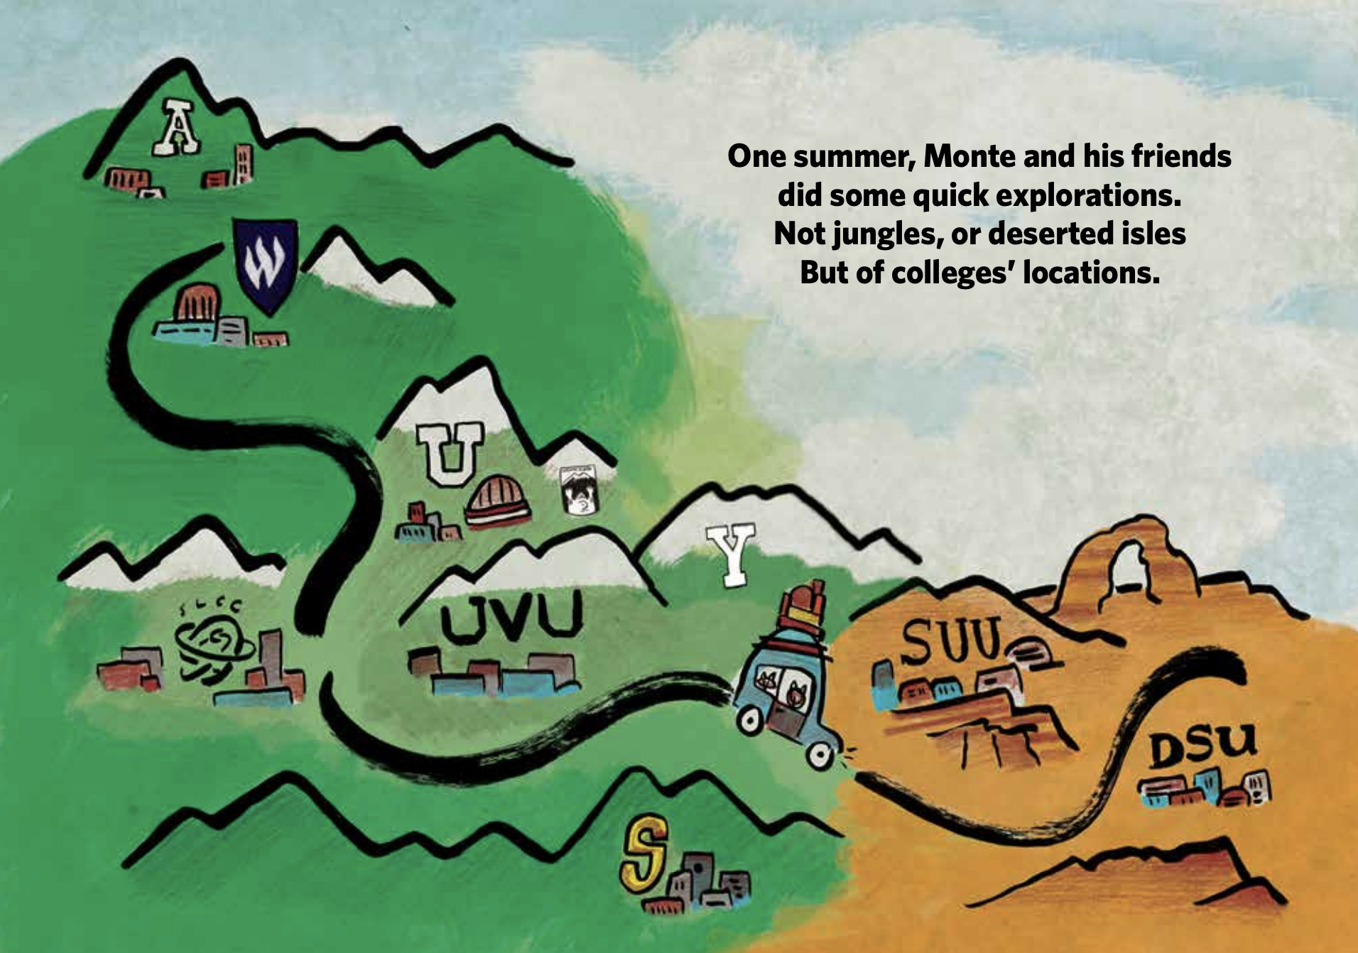
MONTE BOOKS & ACCOMPANYING ACTIVITIES

Slide 27
COLLEGE APPLICATION OPEN HOUSES
All of the USHE schools have begun creating college open houses, where application fees are waived, in coordination with UCAW, due to the interest and volume of participation when planned around UCAW month.

Slide 28
ADULT LEARNER
TAILORED COLLEGE
APPLICATION OPEN
HOUSES
FREE PARKING
KID FRIENDLY
REFRESHMENTS INCLUDED
UVU RESOURCE FAIR
FEE APPLICATIONS WAIVED
Notes:
UVU is the largest 4-year, public institution in the state and they plan and host open houses around UCAW month.

Slide 29
LEVERAGING PARTNERSHIPS
Utah Higher Education Assistance Authority (UHEAA)
my529
United Way
Utah Association of Collegiate Registrars and Admissions Officers
LEVERAGING PARTNERSHIPS
Utah Higher Education Assistance Authority (UHEAA)
my529
United Way
Utah Association of Collegiate Registrars and Admissions Officers (UACRAO)
Notes:
This year UCAW & FAFSA nights have one joint registration application
This year my529 is creating activity worksheets for schools to use during the month of UCAW to talk to students about saving money
United Way helps to provide schools in their college impact network with a deep data dive– these dives have highlighted the impacts participation in FAFSA nights have when schools schedule them in coordination with UCAW events
UACRAO has been a long standing partner for UCAW– annually they provide UCAW schools with “how to application” sheets and fee waivers and financial assistance for students in need; this year they will also provide CE transfer to full student guide

Slide 30
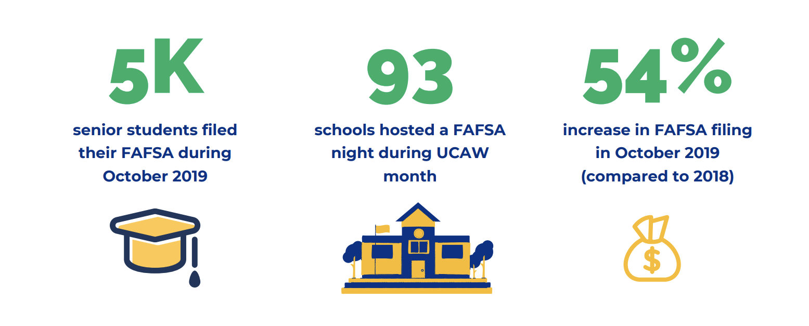
UCAW & FAFSA COMPLETION
2019 UHEAA DATA

Slide 31
HOW ARE YOU ALL EXPANDING YOUR COLLEGE APPLICATION REACH IN YOUR STATES?

Slide 32
CONTACT INFORMATION
Laís K. Martinez
College Access Coordinator, USHE
lmartinez@ushe.edu
801.366.8454 W
801.651.7325 C

Slide 33
Expanding YOUR reach to new audiences: maximizing the application season within the early grades
Heather McChesney Coordinator of Curriculum and Professional Development WV Higher Education Policy Commission | WV Community and Technical College System
EXPANDING YOUR REACH TO NEW AUDIENCES American College Application Campaign

Slide 34
In 2013, West Virginia piloted the expansion of CAEW with the new grantee WV GEAR UP middle schools in addition to the statewide inclusion of all participating high schools. The pilot year was successful, leading WVHEPC to invite all high schools, middle schools, elementary schools, and Pre-K schools across the state to participate from that point forward.
EXPANDING YOUR REACH TO NEW AUDIENCES American College Application Campaign

Slide 35
Expansion hows…
* Present, present, present
* Feeder schools: WVGU and CAEW participating high schools
* Social Media Outlets
* Creation of NEW age appropriate materials
* Personal connections
* Conversations with district stakeholders.
EXPANDING YOUR REACH TO NEW AUDIENCES American College Application Campaign

Slide 36
CFWV CAEW 2013: PK, Elementary, Middle School, K-12
33 schools participated
EXPANDING YOUR REACH TO NEW AUDIENCES American College Application Campaign

Slide 37
Heading Subheading
EXPANDING YOUR REACH TO NEW AUDIENCES American College Application Campaign

Slide 38
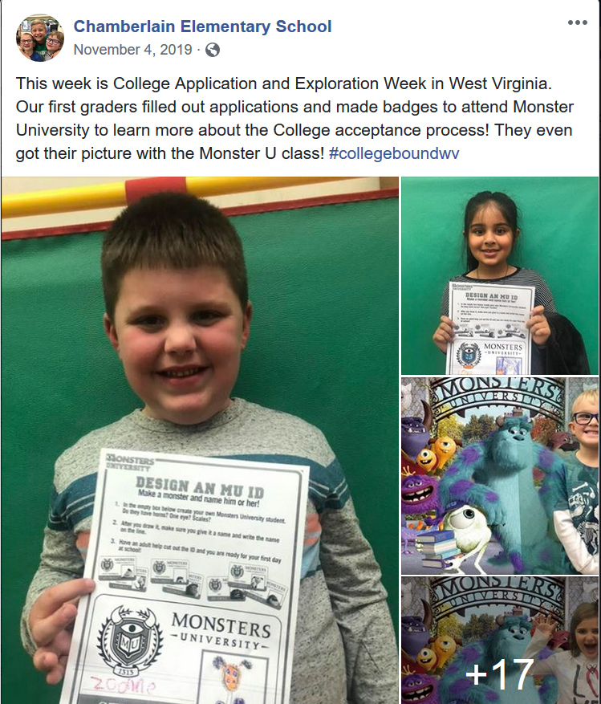
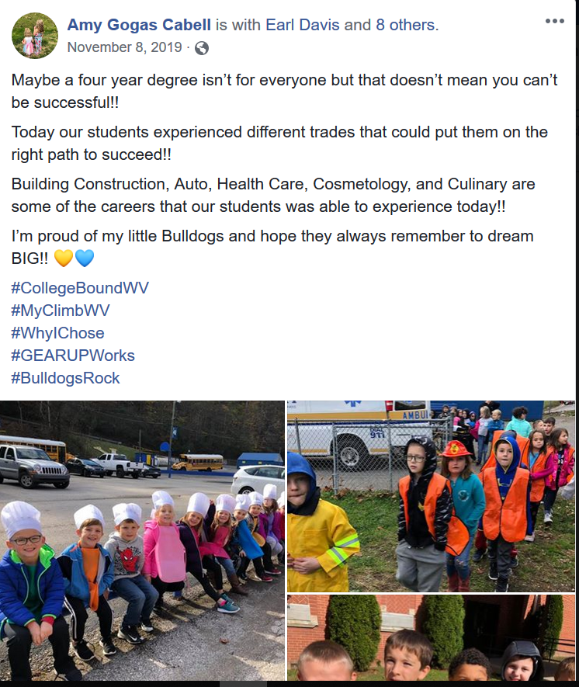
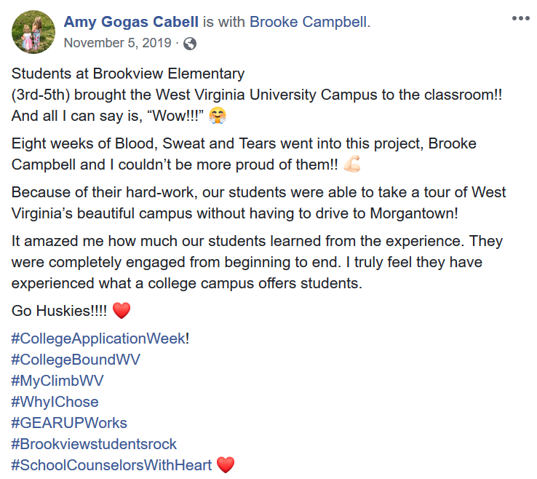
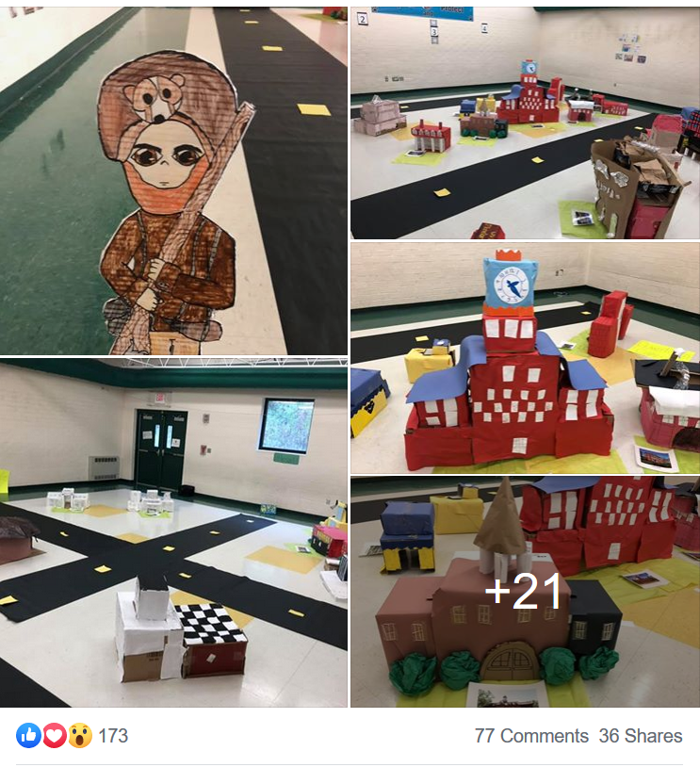
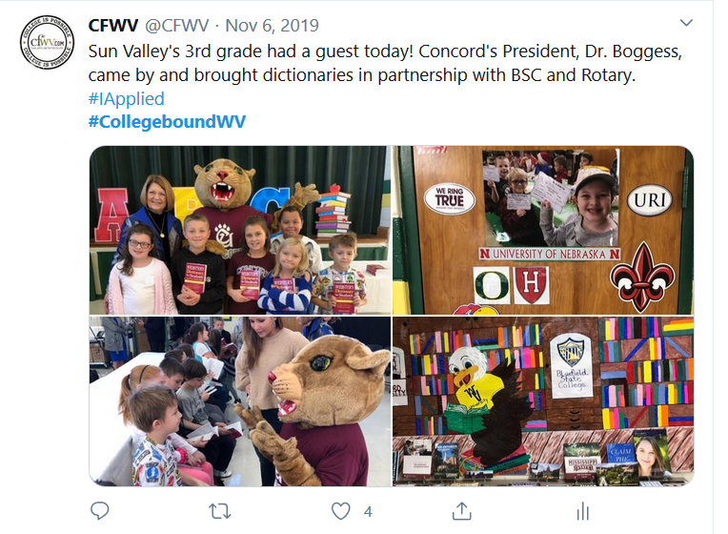
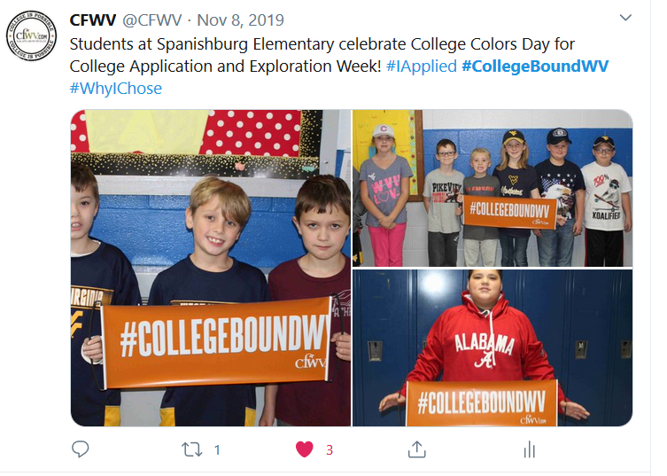
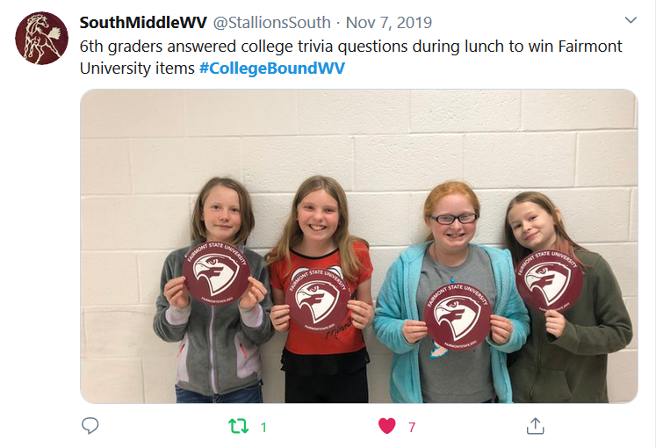
EXPANDING YOUR REACH TO NEW AUDIENCES American College Application Campaign

Slide 39
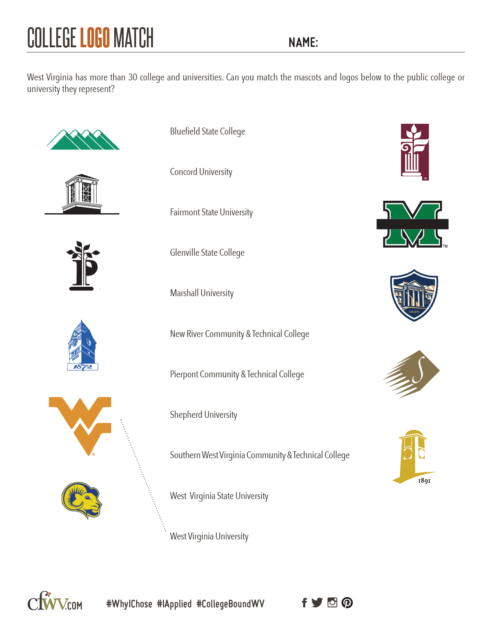
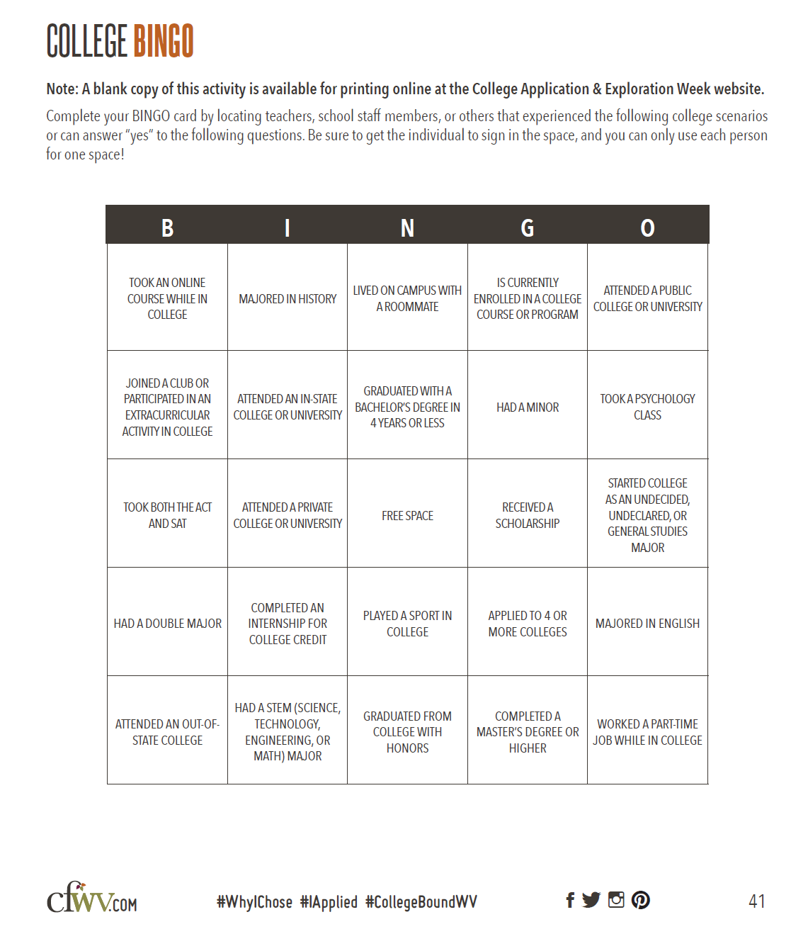
EXPANDING YOUR REACH TO NEW AUDIENCES American College Application Campaign

Slide 40
What is next for CFWV’s College Application & Exploration Week?
Focus Shift: With the onset of the consolidation of schools and a decline in student population, WVHEPC is moving our focus to the % of participating public schools and students rather than the total number # of schools and students participating. In addition, we are continuing to increase our goals and expectations of adding more
early grades, home schooling groups, Adult Learners, libraries, youth organization groups, and working even more closely with our college partners to increase our number of applications submitted during the College Application & Exploration Week.
EXPANDING YOUR REACH TO NEW AUDIENCES American College Application Campaign

Slide 41
EXPANDING YOUR REACH TO NEW AUDIENCES American College Application Campaign

Slide 42
Heather McChesney Coordinator of Curriculum and Professional Development WV Higher Education Policy Commission | WV Community and Technical College System Website: CFWV.com Email: Heather.McCheshney@wvhepc.edu Phone: 304.558.0655
EXPANDING YOUR REACH TO NEW AUDIENCES American College Application Campaign

