Slide 1
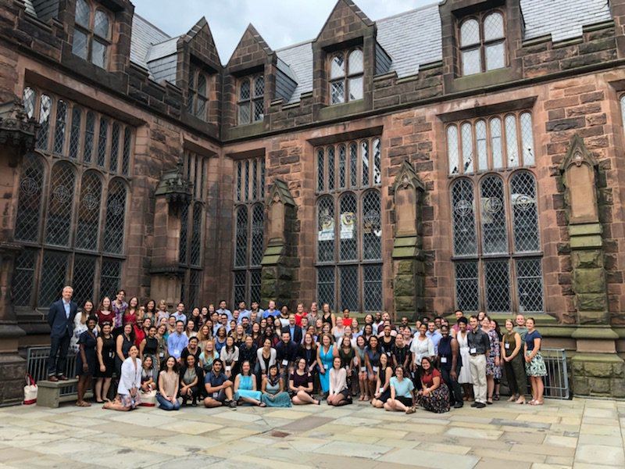


Free college advising.
Wherever you are.

Slide 2
CollegePoint Challenge
Each year, tens of thousands of hardworking, high-achieving students from low- and moderate-income families do not apply to leading colleges and universities that they are qualified to attend.

Slide 3
Our Mission
Increase the number of high-achieving low- and moderate-income students who apply to and enroll in top colleges and universities nationwide.

Slide 4

Our Students

Slide 5



Our Approach
Identify eligible students
GPA ≥ 3.5
A score ≥ 90th percentile on the PSAT, SAT, or ACT
Or taken or currently enrolled in at least 2 college-level courses
An earned family income ≤ $80,000 per year
Partner with mission-aligned organizations such as ACT, the College Board, Jack Kent Cooke Foundation
Engage Students
Each student receives a virtual advisor from one of our advising partners who provide students with the support they need to navigate the college application process
Assess and Improve
By working with researchers at UVA and Stanford we are able to continually improve advising for students
Notes:
Since 2014 we have served over 60k students

Slide 6




Our Advising Partners
Notes:
Talking Points:
Virtual advisors provide support through the college and financial aid application and choice cycle. Texting, emails, phone and video calls. We know from our qualitative study that some students have contact with their advisor over 30 times.

Slide 7
Our
Reach
Over 70,000 high-achieving lower-income students have participated in CollegePoint from 2014 – 2021:
Currently working with 9,000 class of 2021 students
Goal to work with 8,000 class of 2022 students, recruitment opens until Oct. 15th
But we can’t do this work alone. We need partners like you to help us to connect with potential CollegePoint students.
PARTNER TOOLKIT:
https://docs.google.com/document/d/1GjhQj2WiJmFXBSwooZ6sOcGmsKRUjjLfVRB5qZsWD_o/edit?usp=sharing
Notes:
Talking Points:
Virtual advisors provide support through the college and financial aid application and choice cycle. Texting, emails, phone and video calls. We know from our qualitative study that some students have contact with their advisor over 30 times.

Slide 8

American Talent Initiative Approach
Increasing the demand for high-achieving lower income students applying to top colleges
Grown from 30 to 131 members since December 2016
Increased enrollment of students who receive federal Pell grants by 13,000 in three years
Launched Communities of Practice focusing on community college transfers and veterans
+50,000
Shared Goal:
additional low- and moderate-income students at the top US colleges and universities by 2025
https://americantalentinitiative.org/

Slide 9
Assessing
Our Impact
“Last year at around this time, I had plans to go to community college and then transfer to state school after two years because that’s what I thought we could afford. That’s what a lot of my friends in similar situations did, and that’s what I thought was in store for me. Thanks to Joe, I’m now going to one of the top universities in the world.”
– Jorge, Fishers, IN; Attending the University of Chicago
Notes:
We know that our approach has made a substantial difference to the lives of individual students lives from the stories we hear. Here’s Jorge from Indiana, who had plans to go to college, but never imagined himself going to a place like the University of Chicago.
We also wanted to understand what was happening more broadly and how we could improve our methods to make an even greater impact.

